Slide 1

Inspired Faith, Effective Action
UUSJ
November 23, 2013
. . .supporting congregational action for social change
Presented by Annette Marquis and Jennifer Toth,
Multicultural Growth and Witness

Slide 2
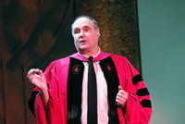

Before SSL, we didn’t have
anything people felt so
unanimously positive about.
It has made congregations feel empowered that they can make a difference.
Rev. Terry Sweetser
UUA Vice President for Stewardship and Development

Slide 3
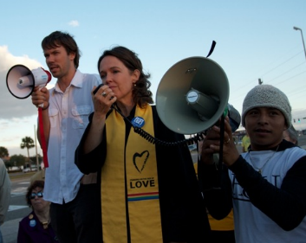
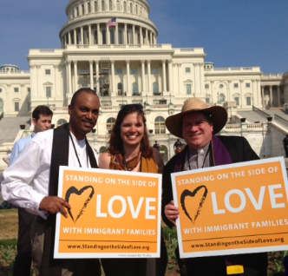

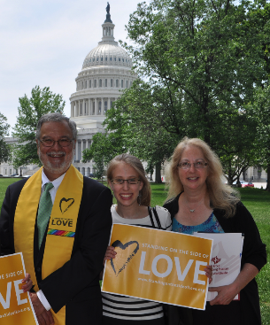
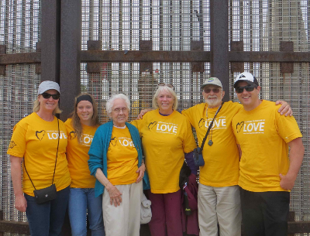

Slide 4
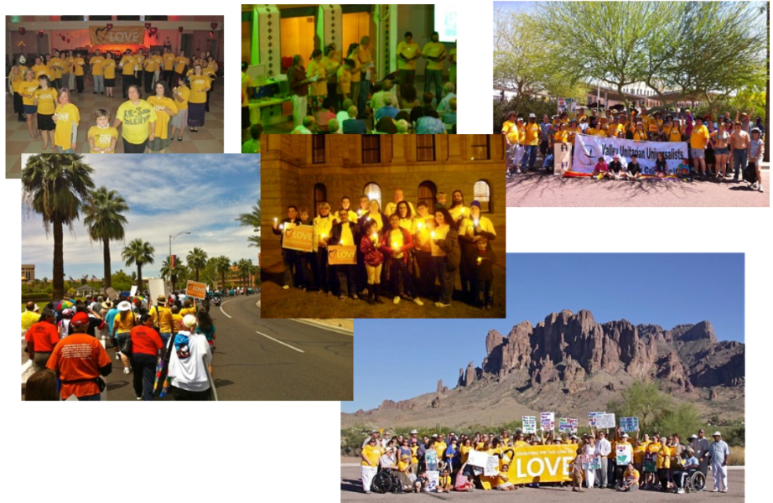
“Not a slogan, a way of living!”
—Valley UU Congregation, Chandler, AZ

Slide 5

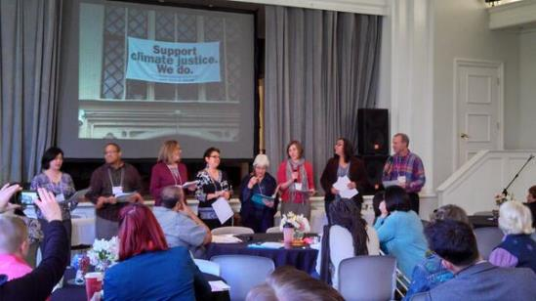
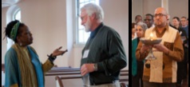

Slide 6
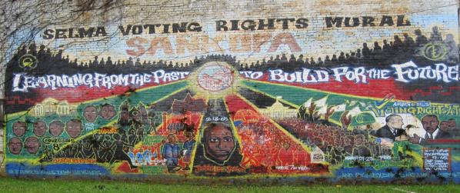
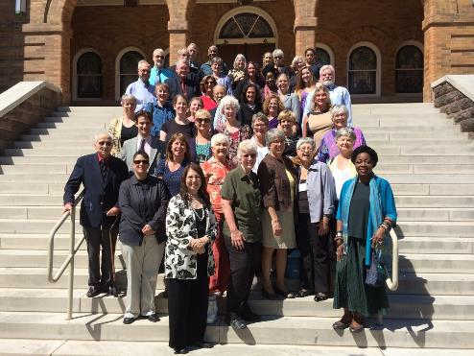

Extracting lessons from
the Southern Civil Rights Movement
to apply to today’s challenges

Slide 7
Spiritually Grounded Social Justice
UU principles and sources
interconnectedness; universal love; inherent worth and dignity; sacred relationships
Religiously grounded justice work
sustains us; provides vision and theological grounding; is transformative; increases authenticity, clarity, and effectiveness
Spiritually grounded congregation-based ministry
fosters spiritual growth; builds community; mobilizes and inspires; authentically explores privilege and oppression; builds partnerships and bridges; provides vision and goals; changes culture

Slide 8
Social justice is spiritual for me, is an expression of my faith, because…

Slide 9
Creating a Collective Vision
Story of Self
Story of Us
Story of Now
Adapted from the work of Marshall Ganz
and modified by the New Organizing Institute

Slide 10
Story of Self
Values that Move You to Act
Courage of introspection
What are your personal stories that have moved you to act?
Why were you called to what you have been called to?
What memories do you have as a child that link to the people, places, events that you value?
Key focus: Choice in the face of challenge

Slide 11
Story of Self
Values that Move You to Act
Focus on:
challenges you had to face
choices you made about how to deal with them
satisfactions – or – frustrations you experienced
What did you learn from the outcomes
What did they teach you about the yourself, your family, the world, about what matters to you?

Slide 12
Story of Us
Values that Inspire Others to Act Together
Courage of empathy
Identifying with each other as a group
Lifting up choices in a group’s history: founding, crises and conflicts, big events
Stories you’ve shared that have meaning to the group
Key focus: Shared story that calls forward shared values

Slide 13
What are your core faith values?
Story of You
What are your deeply held beliefs?
What daily practices can you engage in to live them out?
What values do you see in the world that are not an expression of your faith?
Story of Us
How does your faith community nurture your spirit and help you sustain your commitment to these values?
What can your congregation do to reflect those values?

Slide 14
Story of Now:
Urgent Challenge, Hope, & Call to Action
Courage of imagination
Bringing urgency alive
Calling forward the promise of hope and prophetic vision
Acting on your core values as a religious community
Key focus: Choice that must be made to lead a better future

Slide 15
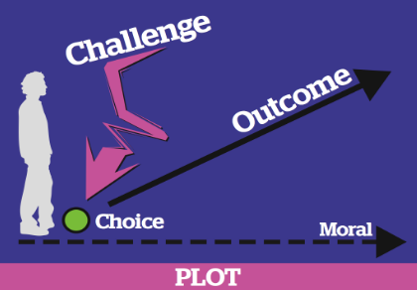
Developing Your Story of Now
For a Story of Us – Story of Now Guide, visit, www.standingonthesideoflove.org and search “Story of Us”

Slide 16
GAFO
Grounding, Accountability, Fit, and Opportunity

Slide 17
Where Do You Put Your Energy?
Grounding
Accountability
Fit
Opportunity

Slide 18
Grounding
Does the issue have authentic and deep UU roots?
Does it link to the current identity, theology, and lived experience of the congregation?
  Theology/philosophy
  Worship & congregational life
  Social action history & today

Slide 19
Accountability
Is the issue of concern to marginalized groups in the congregation and in the community?
Are we in relationship with those groups?
Is right relationship reflection built in to the project and its way of operating? Can we be sensitive partners? Are we educated on the issues? Do we follow others lead?

Slide 20
fit
Is there a match between our resources, aspirations, and ability to make a real difference?
  Informed and inspiring leaders
  Institutional resources – curricula, $
  Partners

Slide 21
opportunity
Can we make a real difference as a respected participant?
Is this a “hot” issue and a good time to act?
Is there a local, state or national campaign or coalition we can join?
Are there debates in the public arena, legislation that UUs can influence?

Slide 22
Assess and Choose with gafo
Potential High Fit and Low Opportunity Study, educate and monitor for development Issues: | Ideal High Fit and High Opportunity Dedicate time, energy, and resources I Issues:
Unlikely Low Fit and Low Opportunity Do not dedicate time and resources. Can monitor for development Issues: | Potential Low Fit and High Opportunity Study, educate, and monitor for development Issues:
FIT
Opportunity

Slide 23
Grounding & Partnering
Tie justice efforts to our UU identity;
tell your story; keep creating the story of us (including in your congregation), develop the story of now
Use GAFO to describe justice ministry
Maintain partnerships; create opportunities for congregation to interact with partners; hold spiritual discussions with partners
Share the plate with social justice partners

Slide 24
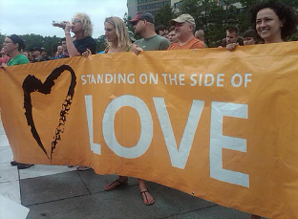
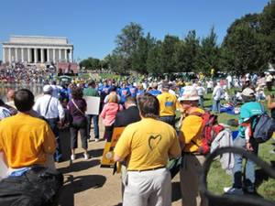
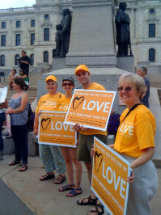
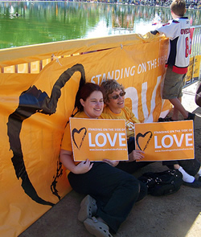
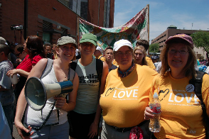
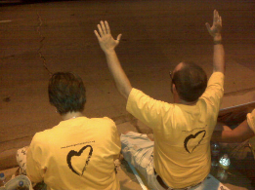
The Love People
The Yellow Shirt People
Be hard to ignore
Tie Public Witness to your Advocacy

Slide 25
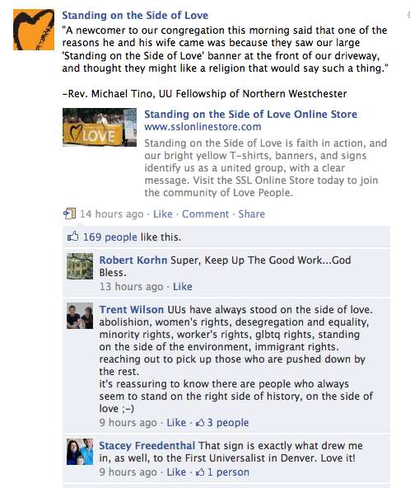
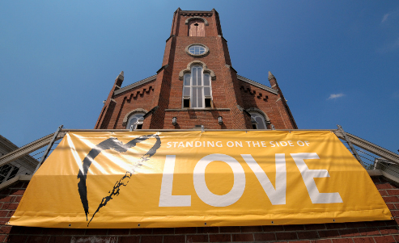
The Power of SSL:
Can’t argue against LOVE!
Faith in action
Pride in an underlying principle of faith
Opportunity to bring our vision to the world
Major visibility
Chance to show up for our partners in a coordinated way as people of faith
Positive messaging infused into what others might call “fights” or “battles”
Denominational branding
Increased media attention
Open source

Slide 26
Lessons Learned
When we stand on the side of love in advocacy setting
Be prepared, and more importantly, be receptive.
Have talking points, but not a script. Aim to engage in dialogue, not deliver a speech.
You don’t have to be a policy expert! It’s better to speak from the heart, offer stories, and share what you know, rather than memorize facts and figures
Make simple one page handouts
Be persistent and follow up!

Slide 27

Closing
Questions?
Stay in touch!
amarquis@uua.org
jtoth@uua.org
You are the Beloved Community!

